Slide 1
Illinois Board of Higher Education
College Changes Everything
What are the Numbers of Latino/a’s
in the Higher Education System

Slide 2
(110 ILCS 660/5-88)
Under section 5 of the Act
Not a citizen or permanent resident of the United States, the individual provides the University with an affidavit stating that the individual will file an application to become a permanent resident of the United States at the earliest opportunity the individual is eligible to do so

Slide 3
Illinois Association for College Admission Counseling
http://www.iacac.org/undocumented/
College Advising Guide for Undocumented Students designed to provide assistance to high school counselors and other individuals who work with undocumented students

Slide 4
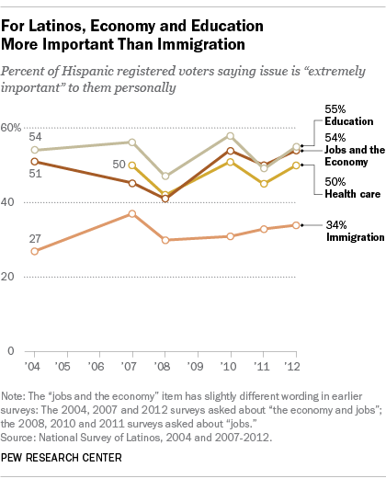

Slide 5
Latino youths who have a high school education or less and are not currently enrolled in school, the reasons they give for not continuing their education are:
Nearly three-quarters (74%) say they need to help support their family.
Half (49%) say their English skills are limited.
More than four-in-ten (42%) say they didn’t like school.
Four-in-ten (40%) say they cannot afford to go to school.
Almost four-in-ten (39%) say they don’t need more education for the career they want.
More than two-in-ten (21%) say their grades were not high enough.
“Hispanics will be 60 percent of our nation’s population growth between 2005 and 2050. However, Hispanics have the lowest education attainment levels of any group in the United States.”
“White House Initiative on Educational Excellence for Hispanics”
Notes:
PEW RESEACH CENTER

Slide 6
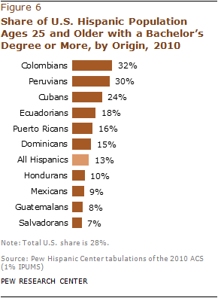
Notes:
PEW RESEACH CENTER

Slide 7
Data on young Latinos is mixed with contradictions.
Young Latinos are satisfied with their lives, optimistic about their futures, and place a high value on education, hard work, and career success.
Yet they are much more likely than other American youths to drop out of school and to become teenage parents.
They are more likely than White and Asian youths to live in poverty.
Notes:
PEW research/Between Two Worlds: How Young Latinos Come of Age in America
I. Overview and Executive Summary/Updated Edition, July 01, 2013

Slide 8
What are some of the Reasons for Latino Student Non-Completion
Affordability and Transfer
Poor time management
Many students are not able to keep pace with rising tuition
Studies have confirmed, students who enroll in community colleges are less likely to complete their educational objectives

Slide 9
Nearly all Latino youths (89%) and older adults (88%) agree with the statement that a college degree is important for getting ahead in life.
However, just under half of Latinos ages 18 to 25 say they plan to get a college degree.
Notes:
PEW Research: Educational Expectations and Attainment/

